Slide 1


Task 6 : Database Design and Implementation
of
Road State, Road Sign Notification App
safewaka- Navigate smarter, Driver Safer
Group 4
te

Slide 2
OUTLINE
Introduction
System architecture and technologies used
Data flow diagram
ER-Diagram
Backend implementation
Conclusion
te

Slide 3
Introduction
SafeWaka is a mobile application designed to enhance road safety and provide drivers with real-time information on road conditions and traffic signs.
Designing the database will enable us to store various types of data including road signs, road states, user information, and notifications and to handle an increasing amount of data as the number of users and the amount of collected data grows.
te

Slide 4
Technologies used in Designing the Database
The backend is responsible for managing data, processing user requests, and interacting with external services.
It utilize technologies like Node.js, Appwrite for authentication, messaging and MYSQL.

Slide 5
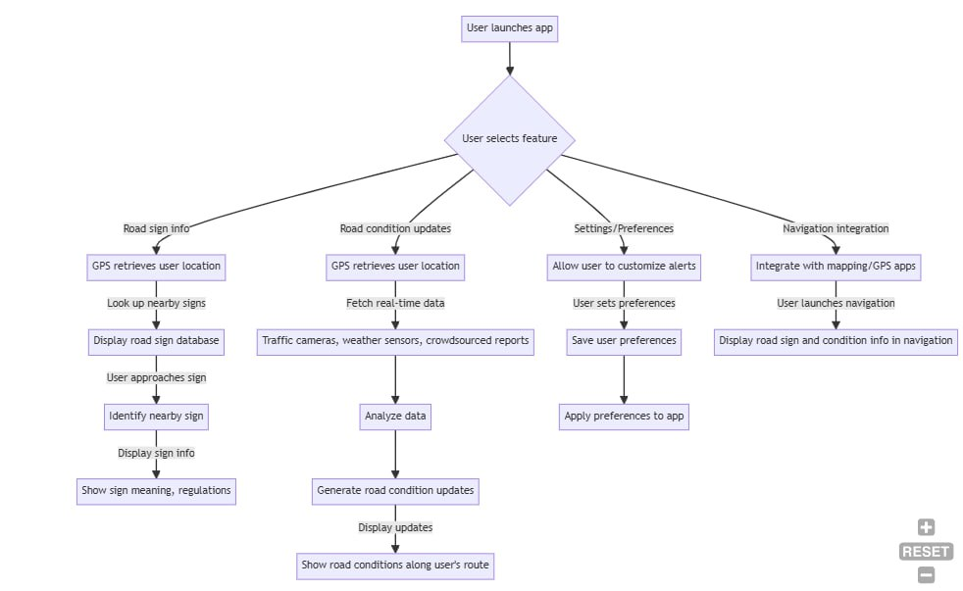
Data Flow Diagram

Slide 6
Entity-Relational Schema
Entity
Attributes
Relationships
Users
Username, Password, Location
Has-Many Notifications
Route
ID, Location, Speed Limit, Road Type
Has-Many Traffic Signs, Has-Many Notifications
Road signs
ID, Type, Location, Message
Belongs-To Route
Notifications
ID, Type, Message, User, Road Segment
Belongs-To User, Belongs-To Road route

Slide 7
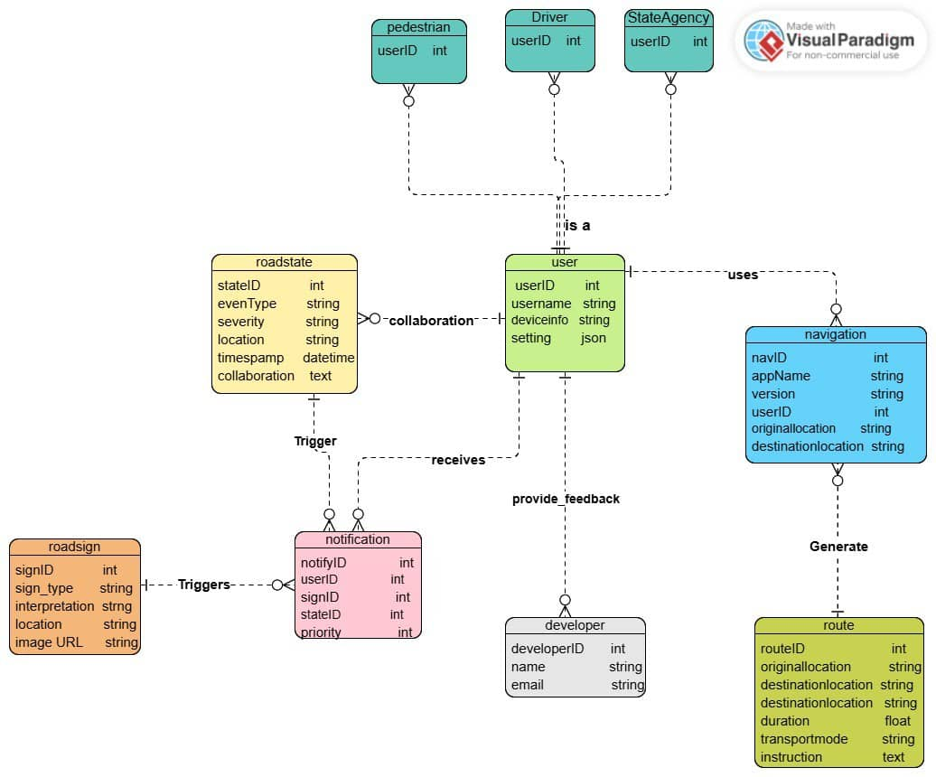
Entity-Relational
Schema Diagram

Slide 8
Backend Implementation
API Design
Data Processing
SafeWaka leverages RESTful APIs to enable communication between the frontend and backend.
The backend processes data from sources, including user reports and external services, to generate real-time information on road conditions and traffic signs.
User Authentication
The backend implements secure authentication mechanisms to verify user identities, protect user data, and ensure secure access to the application.

Slide 9
Data Management
1
Real-time Data Updates
2
Data Validation
SafeWaka utilizes real-time data updates from various sources, such as traffic sensors, road cameras, and user reports, to provide the most accurate and up-to-date information.
The backend performs data validation to ensure accuracy and consistency, preventing erroneous data from being stored and impacting user experience.
3
Data Backup and Recovery
4
Data Analytics
Regular data backups and disaster recovery protocols are implemented to safeguard critical data from loss and ensure the continuity of the application.
The backend utilizes data analytics techniques to identify trends, patterns, and insights from collected data, allowing for improvements to the app and better decision-making.

Slide 10
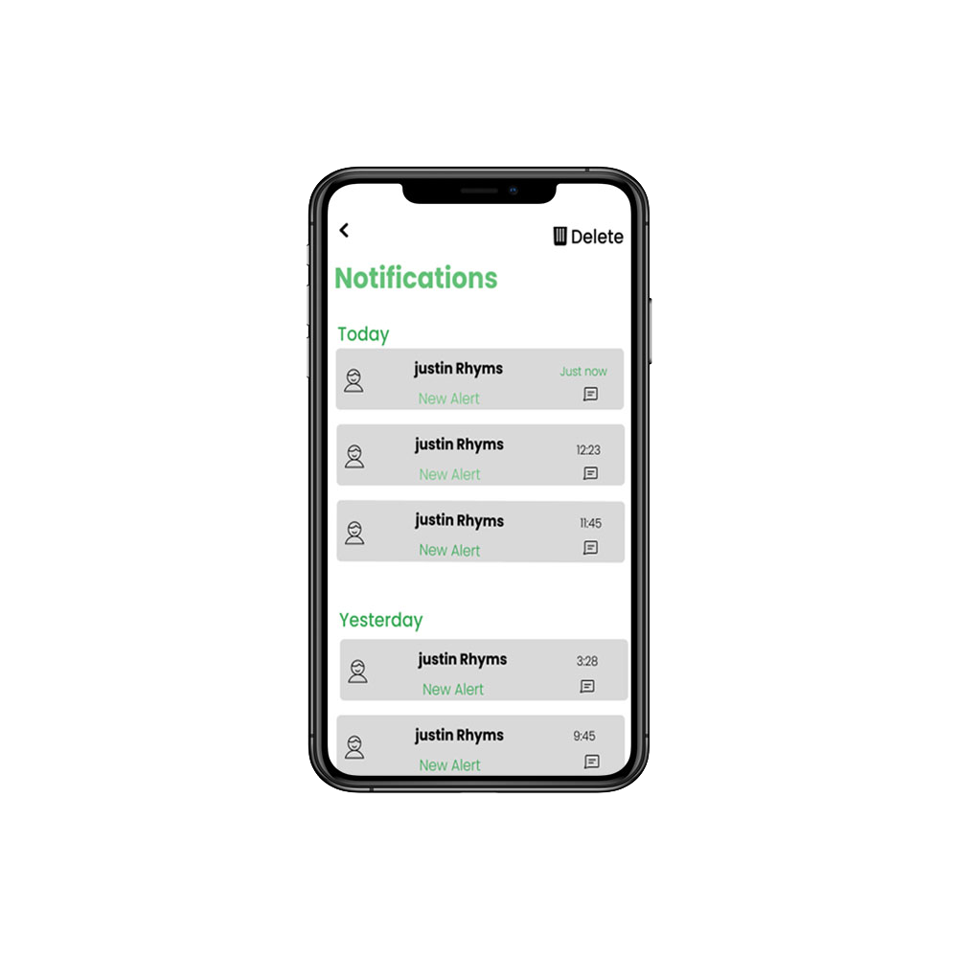



Notification System
Trigger Conditions
Notifications are triggered based on specific conditions, such as road closures, accidents, traffic jams, or approaching traffic signs.
Notification Delivery
The system delivers notifications to users via push notifications, SMS messages, or in-app alerts, ensuring timely and effective communication.
User Preferences
Users can customize notification preferences, allowing them to control the frequency, type, and content of notifications they receive.

Slide 11



Integration with Real Time data Sources
Road Cameras
GPS Devices
Cloud-Based Platform
Live footage from road cameras provides visual context and real-time updates on road conditions, allowing users to make informed decisions.
Integration with GPS devices enables accurate location tracking, ensuring that users receive relevant notifications based on their current position.
The app leverages a cloud-based platform for data storage, processing, and notification delivery, ensuring scalability and reliability.

Slide 12

Conclusion
SafeWaka is a transformative mobile application that addresses the need for real-time road information and promotes road safety. By leveraging advanced technology, the app empowers drivers to navigate roads more safely and efficiently.

